Slide 1
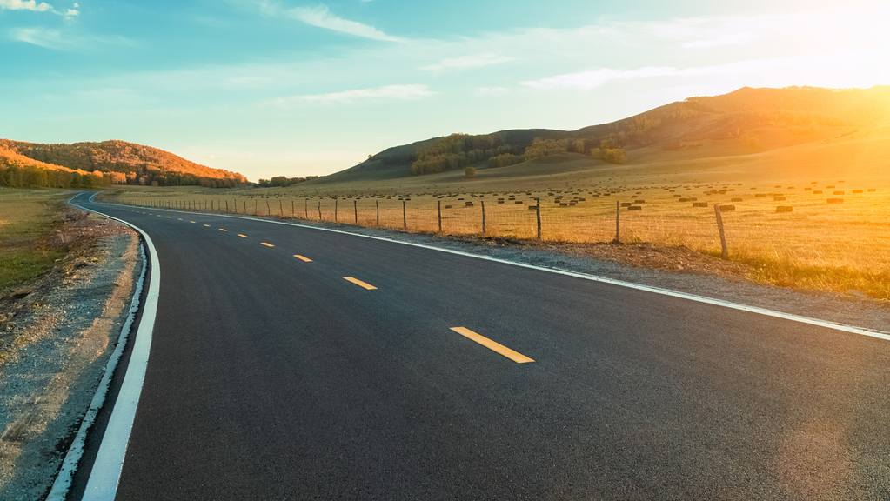

ELITES
Bon Voyage!

Slide 2
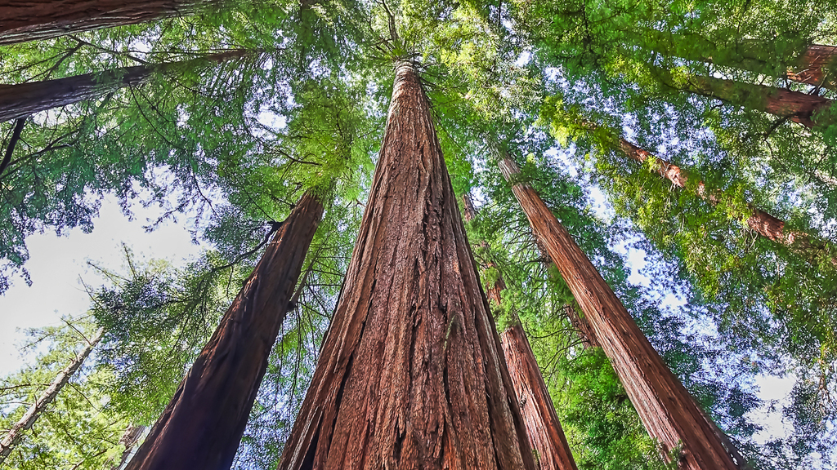
TEAM
Our
Roopa Thangam R
Sandhya A
Subhashini K S
Swathi T S
Vasundhra V
Vidya A

Slide 3
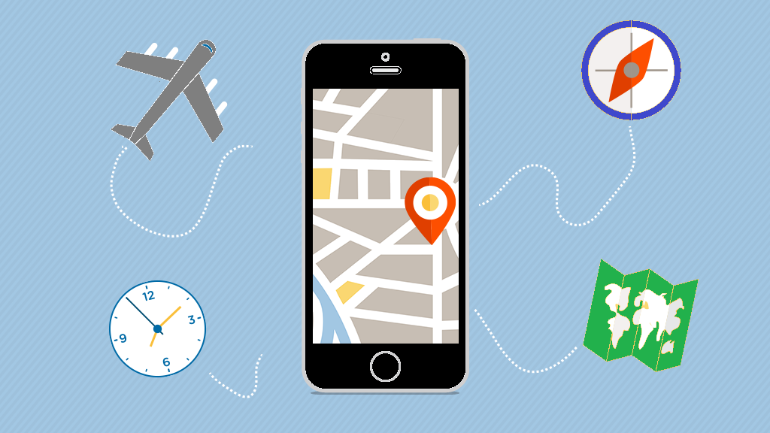
Our project
About
While everyone wants their trip to be a perfect getaway, vacations rarely run so smoothly. Travellers face a lot of issues during their travel due to lack of clear plan. They face problems like delayed/cancelled flight , overbooked hotels, lost or stolen money due to lack of security, car rental cancellation , getting sick , missing out important spots, etc .
But, we have come up with a solution to avoid such situations and make the best of the trip. We have designed an application through which one can select the required destination and can get details about the nearby restaurants/café , hotels , car/bike rentals , supermarkets , hospitals , entertainment spots, must visit places , travel tips and even blogs of previous travellers. Its like all under a single application so that one can make the best use of their trip and have a pleasure time.

Slide 4
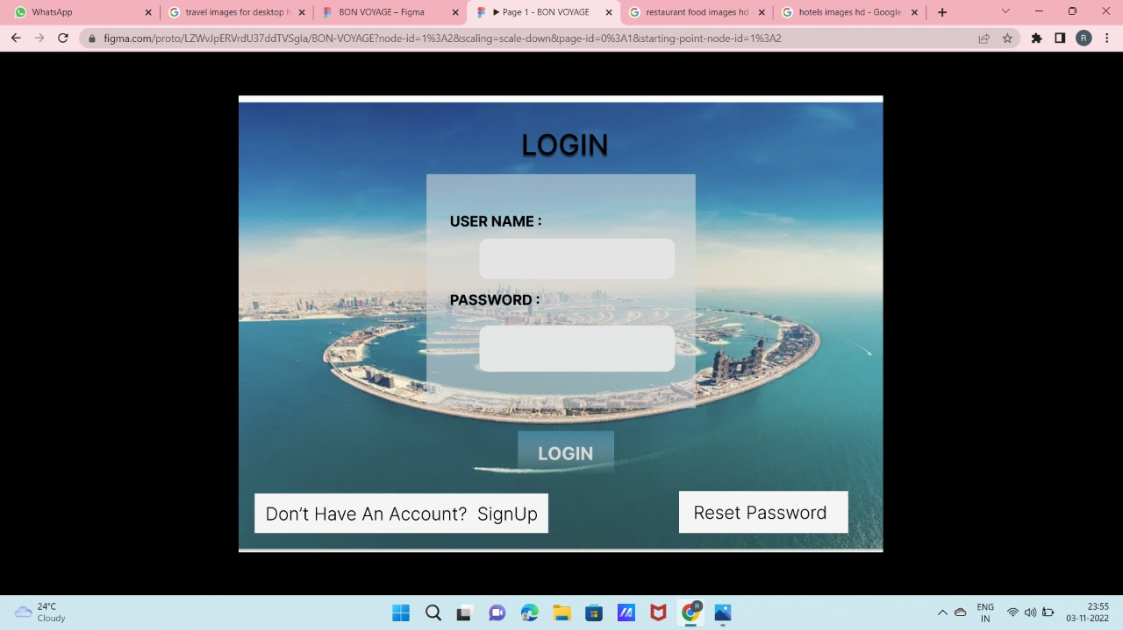
Desktop 1 – Login page

Slide 5
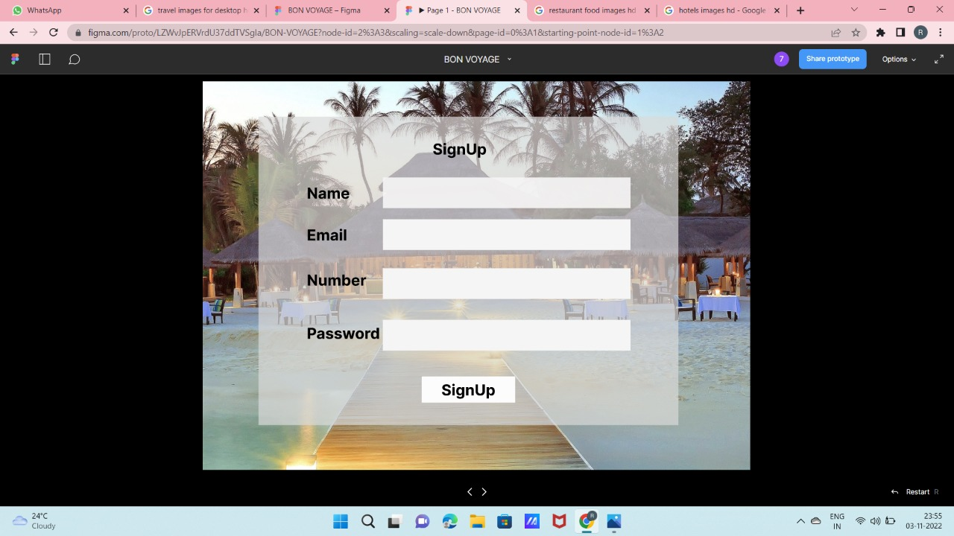
Desktop 2 – Sign up page for new users

Slide 6
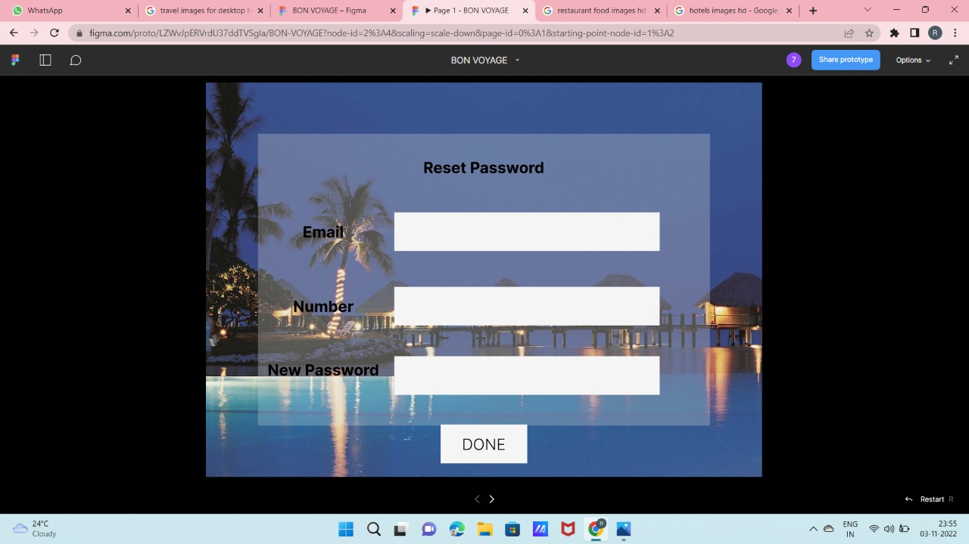
Desktop 3 – Reset password option for users who forgot password

Slide 7
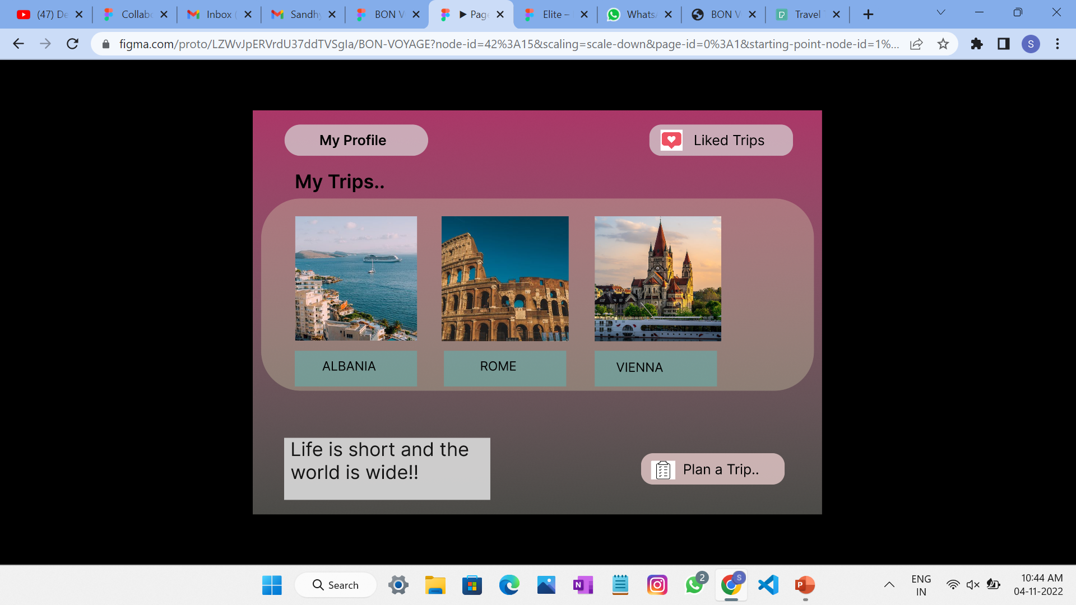
Desktop 8 – After logging in, users can view their profile where history of past trips can also be viewed. One can start planning a trip by clicking “Plan a Trip”.

Slide 8
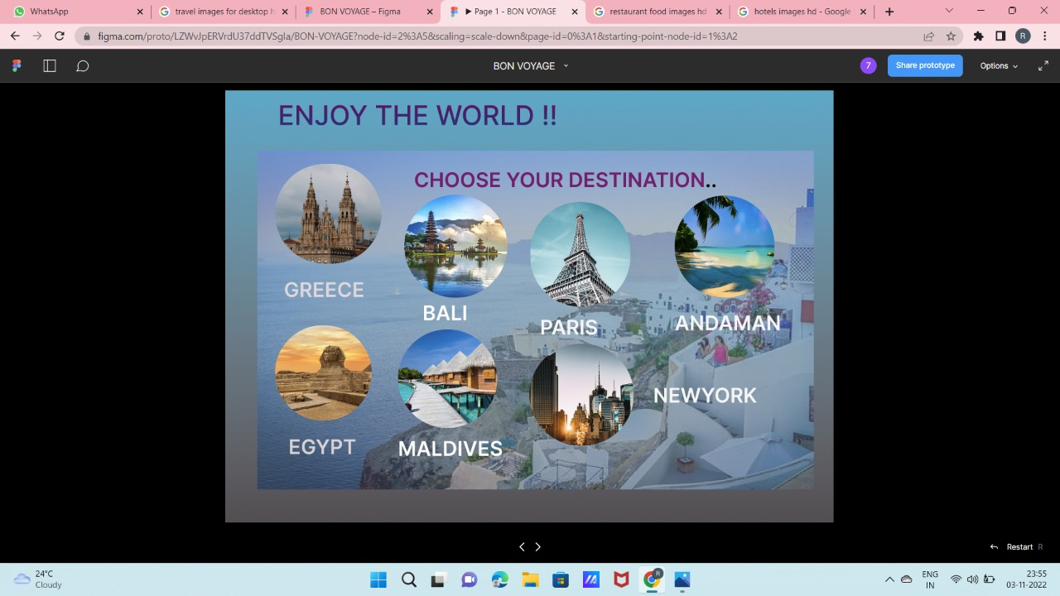
Desktop 4 – The very first process in planning a trip where users begin by selecting the destination.

Slide 9
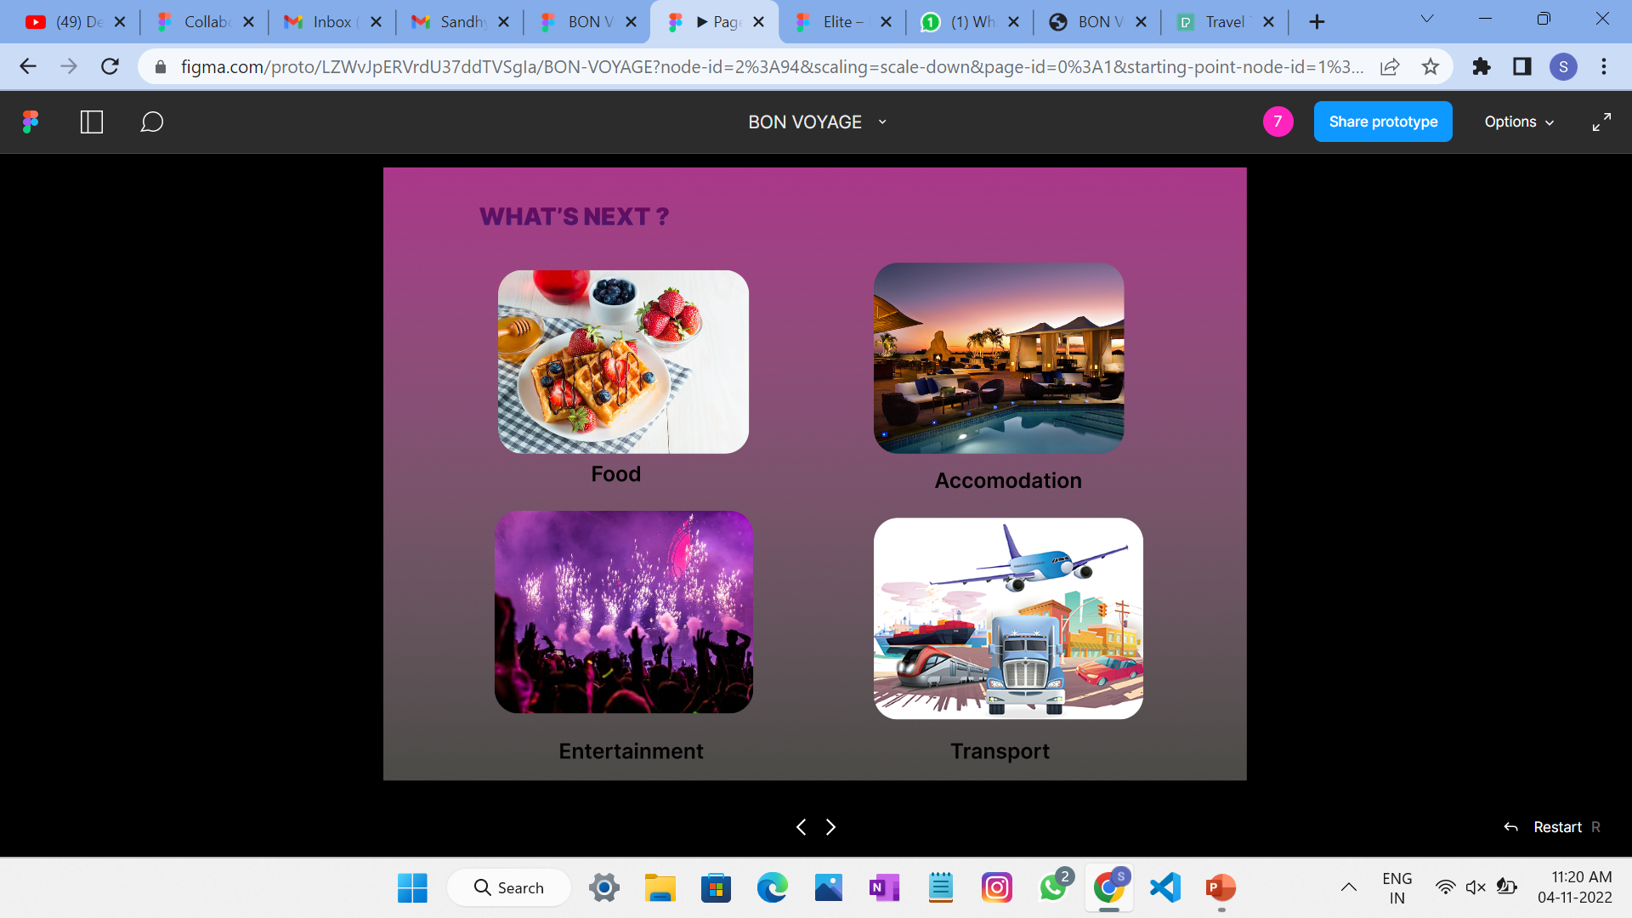
Desktop 5 – After choosing the destination , travellers can select any option according to their requirement. It can be either nearby restaurants/café , or hotels, or entertaining spots, or any modes of transport.

Slide 10
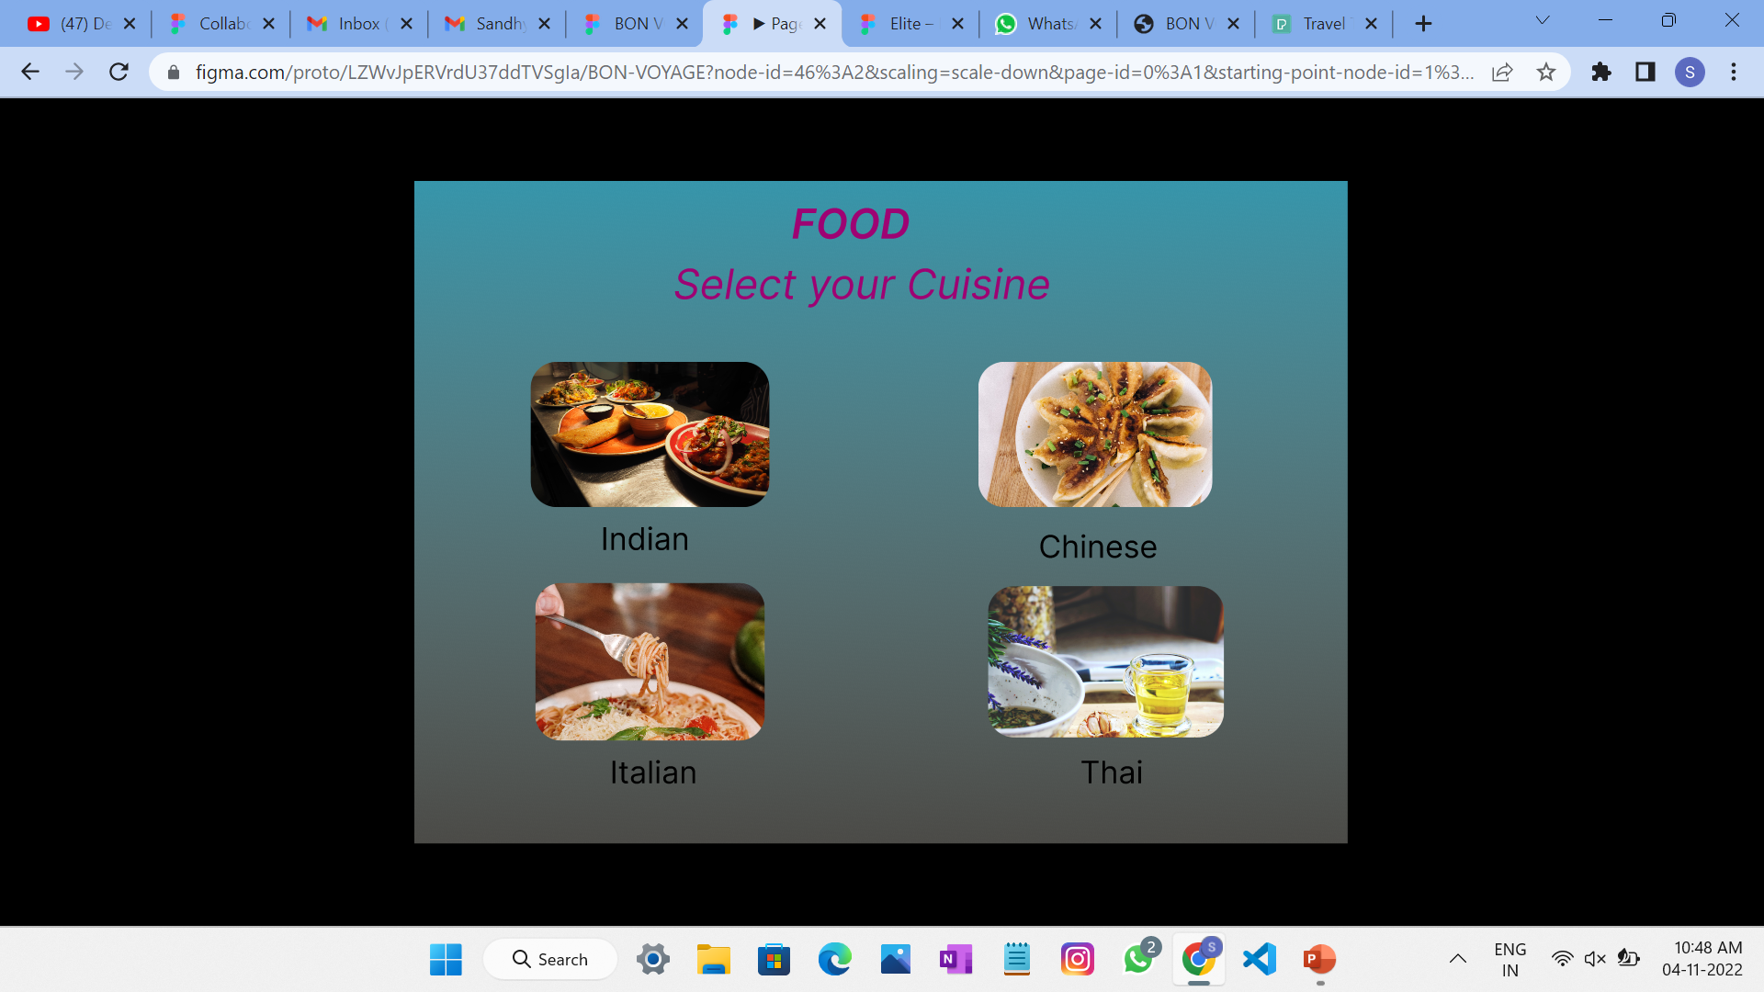
Desktop 9 – Search for your favourite foods nearby based on cuisine.

Slide 11
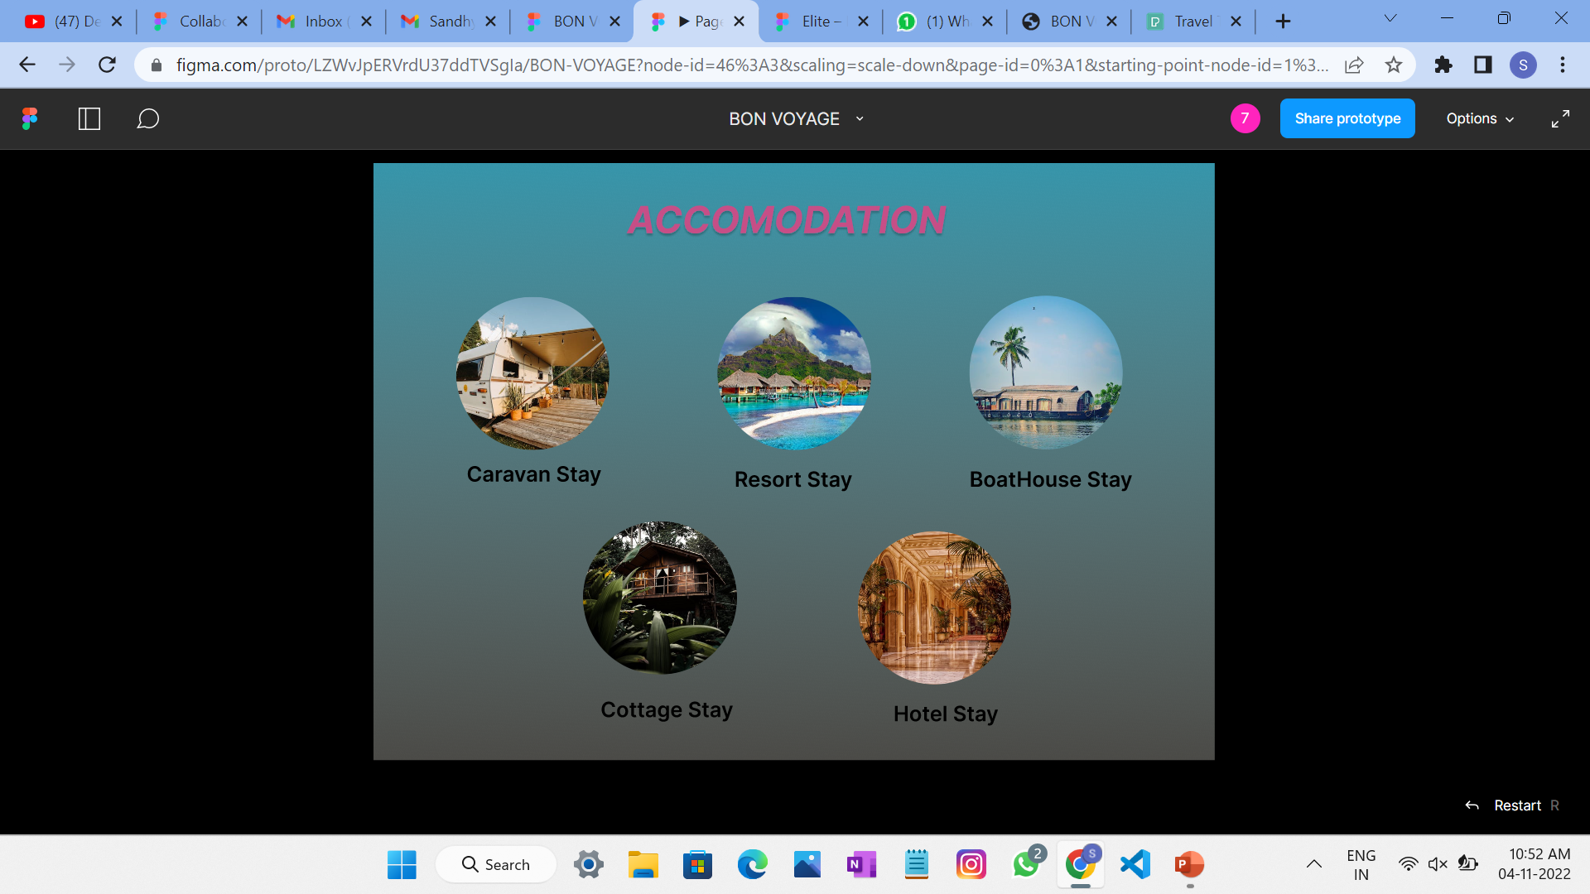
Desktop 10 – Search for accomodations nearby based on place of stay.

Slide 12
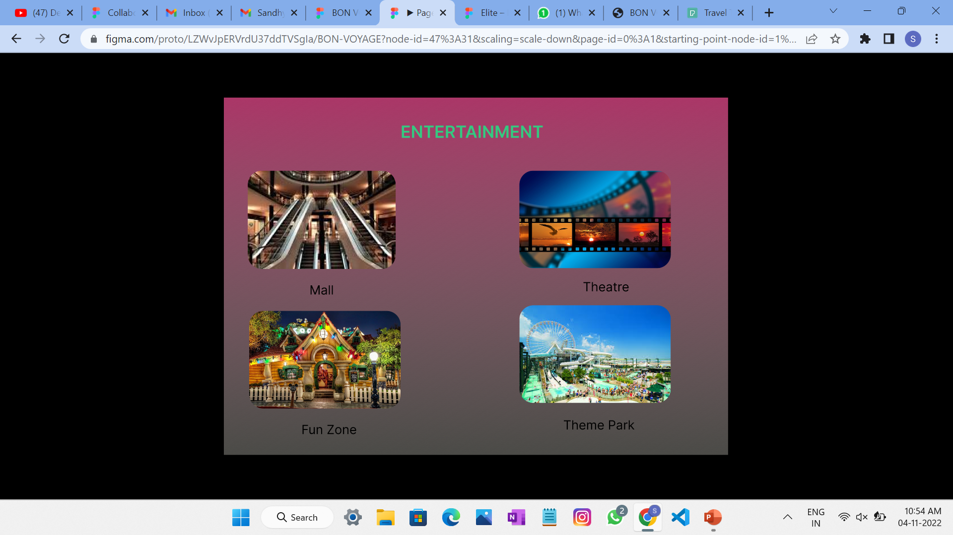
Desktop 11 – Look for means of entertainment nearby like malls, theatres, theme parks, etc.

Slide 13
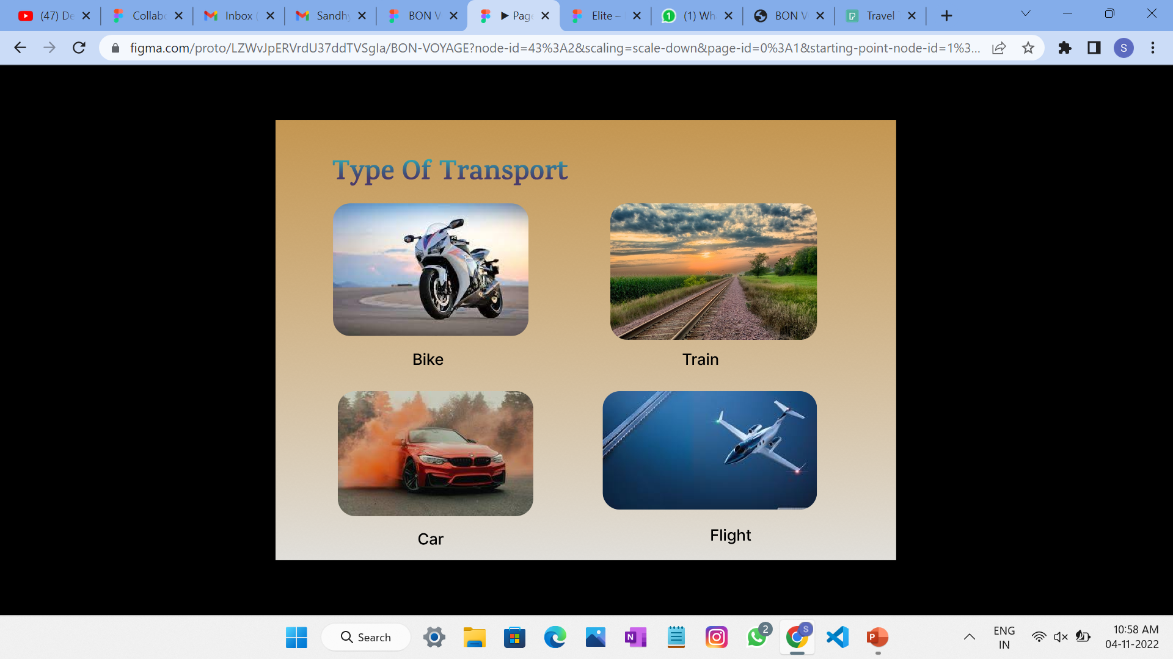
Desktop 6 – Look for all modes of transport nearby so that it will make travelling easier.

Slide 14
Project link
Our
https://www.figma.com/file/LZWvJpERVrdU37ddTVSgIa/BON-VOYAGE?node-id=0%3A1
https://www.figma.com/proto/LZWvJpERVrdU37ddTVSgIa/BON-VOYAGE?node-id=2%3A94&scaling=scale-down&page-id=0%3A1&starting-point-node-id=1%3A2
GITHUB LINK: https://github.com/Subhashini-KS

Slide 15
THANK YOU!
the end,
Cheers to Happy Tales Of Traveling!!!

